Slide 1
Our team
Umer Ahmed
BCS203182 SECTION 2
Muhammad Harris
BCS203193 SECTION 2

Slide 2
HOW CLOSE ARE WE TO TERRAFORMING MARS?

Slide 3
01
Mars
All About the Red Planet

Slide 4
Namesake in Ancient Astronomy
Egyptians
Babylonians
‘Her Desher’ means ‘The Red One’
‘Nergal’, Hero and King of Conflicts
Greeks
Romans
Named it after Ares, Greek God of War
Copied Greeks, Calling the planet ‘Mars’, Roman God of War

Slide 5
Surface of Mars
The Bright Red color of Mars is due to iron-rich minerals covering its surface in form of dust and rocks. According to NASA, these minerals get kicked up in the atmosphere due to strong wind currents and after oxidization and rusting of these elements, Mars appears to be bright red from a distance.

Slide 6
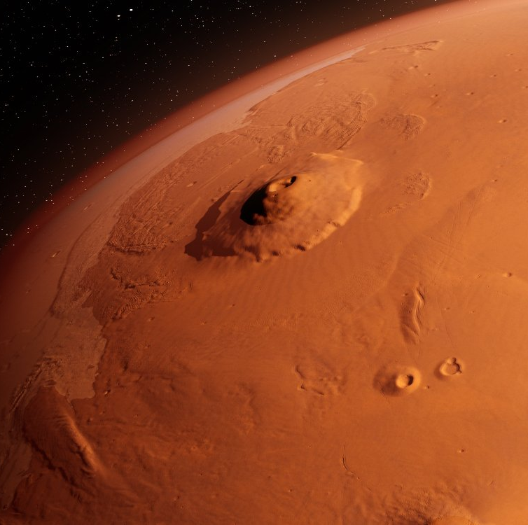
Olympus Mons, Largest Volcano in Solar System
It is approximately three times the size of Mount Everest and roughly 27 kilometers high.

Slide 7
Size & Distance
147.17 Million KM
228 Million KM
Sun
Earth
Mars
12,742 KM in Diameter
6,779 KM in Diameter

Slide 8
How Time Elapses on Mars?
One Day
Mars completes one rotation in 24.6 hours. Martian Days are called Sols.
One Season
One individual Martian season can last upto 194 sols or 200 Days.
One Year
One Martian year is about 669.6 sols or 687 Earth Days.

Slide 9

Composition of Martian Atmosphere
Nitrogen
Carbon Dioxide
10%
3% Nitrogen Gas
95% Carbon Dioxide
25%
35%
Oxygen
Other Gases
0.16% Oxygen Gas
30%
Helium, Argon etc.
Such high amount of Carbon Dioxide in Martian atmosphere makes it extremely thin. This makes it impossible for liquid water to exist on Surface of Mars

Slide 10
Moons of Mars
Phobos
Larger of the two moons. Its surface is covered by craters formed by asteroids
Deimos
Smaller of the two moons. Its surface is covered in loose dust

Slide 11
—NASA
“Every 100 years, Phobos comes 1.8 meter closer to Mars. Hence, in approximately 50 million years, it will crash into surface of Mars breaking the planet in half.”

Slide 12
Liquid Water Existed on Martian Surface Long Ago
NASA’s Perseverance Rover found evidences that liquid water used to flow on Martian surface 3.8 Billion years ago

Slide 13
02
Terrafroming Mars
How can we Terraform Mars

Slide 14
What is Terraforming?
“Terraforming of a planet, moon, or other body is the hypothetical process of deliberately
modifying its atmosphere, temperature, surface topography or ecology to be similar to
those of Earth to make it habitable by humans.”

Slide 16
Methods of Terrafroming Mars

Slide 17
Nuke Mars
By detonating thermonuclear weapons over the poles, we could effectively trigger a greenhouse effect on Mars. The bombs would release heat, which in turn would melt the carbon dioxide
frozen at the poles and, in theory, help to immediately thicken Mars' thin atmosphere. As sunlight is trapped by the C02, the temperature would rise, more ice would melt, and so on.

Slide 18
Giant Orbital Mirror
Placing a giant orbital mirror in Martian orbit would reflect sunlight to surface. This sunlight will help trigger green house effect, increasing temperature and melting ice on northern pole of Mars.

Slide 19
Human-Engineered Microbes
NASA revealed earlier this year that they might be able to come up with something that will allow them to build new life from the genes of different microorganisms. This could result in genetically engineered plants, algae and other organisms that could survive, thrive and maybe even heat up Mars.

Slide 20
Crashing Asteroids on Mars
Like nuclear weapons, the other more destructive method would be to have several 10-billion ton asteroids smack directly into the planet. Just one would result in a global temperature spike of 37 degrees Celsius. Some have even suggested to crash Phobos into Mars.

Slide 21
Green House Factories
The idea behind building factories powered by renewable energy on the red planet with the sole purpose of releasing methane, carbon dioxide, CFCs, water vapor and other greenhouse gases into the atmosphere. While this process would take centuries to warm Mars, it would allow humans plenty of time to settle the planet and help prepare it for its future role as a "new Earth."

Slide 22
Problems with Terraforming?
01
02
Ethical
Economical
Will Mars end up just like Earth?
Too Expensive🥵💸

Slide 23
Conclusion
Science Fiction or Reality?

Slide 24
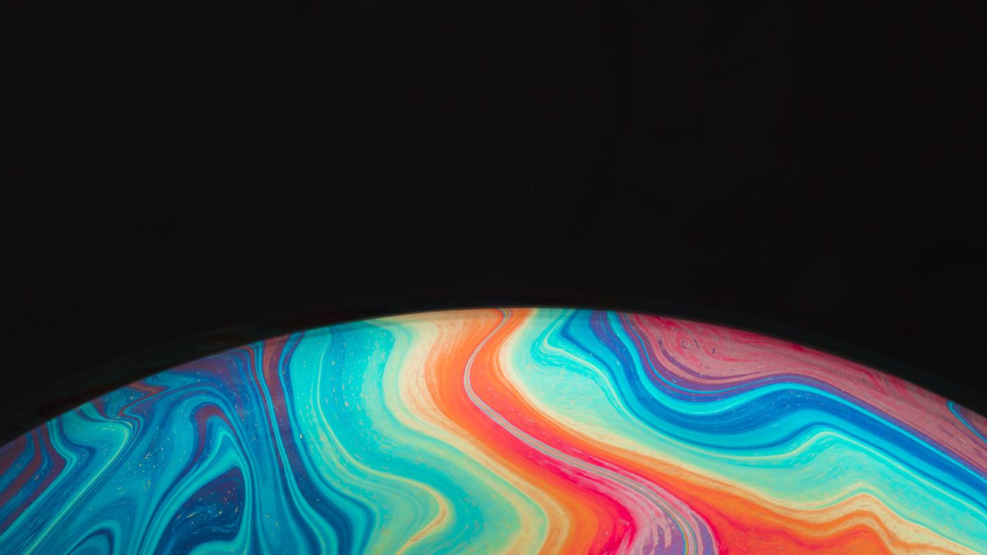
Question?

